Slide 1
Stocko Sprint 1 Presentation
Alex Davis, Andrew Setka, Brendan Lucich, Brady Mack

Slide 2
Project Focus
The main goal of Stocko is to provide our users with an on-the-go web-based application that allows them to view their current positions in the market provide long-term buying and selling evaluation metrics based off our backend business data calculations with a value investing methodology

Slide 3
Sprint 1 Goals
Bootstrap Wiki and Website Application
stocko.xyz
Research value investing methodology with Graduate Finance Students
Technology Goals
Flask API (communication between frontend and backend processing)
Alpha Advantage API (communication between backend process and 3rd party stock data)
Authentication
Website routing
Complete 3 main features for Sprint 1 (next slide)
Aspects of these features will change and evolve in future sprints

Slide 4
Major Sprint Achievements
Log-in Authentication Integration with Route Guarding
Stock Evaluation Feature
Positions Feature
Alpha Advantage gave us a needed increase in requests per minute

Slide 5
Project Backlog and Sprint Backlog
Jira
https://housing.atlassian.net/jira/software/projects/STOCKO/boards/2/backlog
Downloadable Version can be found at
https://stocko.xyz/wiki/deliverables
Tickets not addressed in Sprint 1 will be pushed to Sprint 2 or Backlog depending on importance
Sprint 2 Planning will start with defined features to achieve, followed by a though ticket and poker planning session

Slide 6
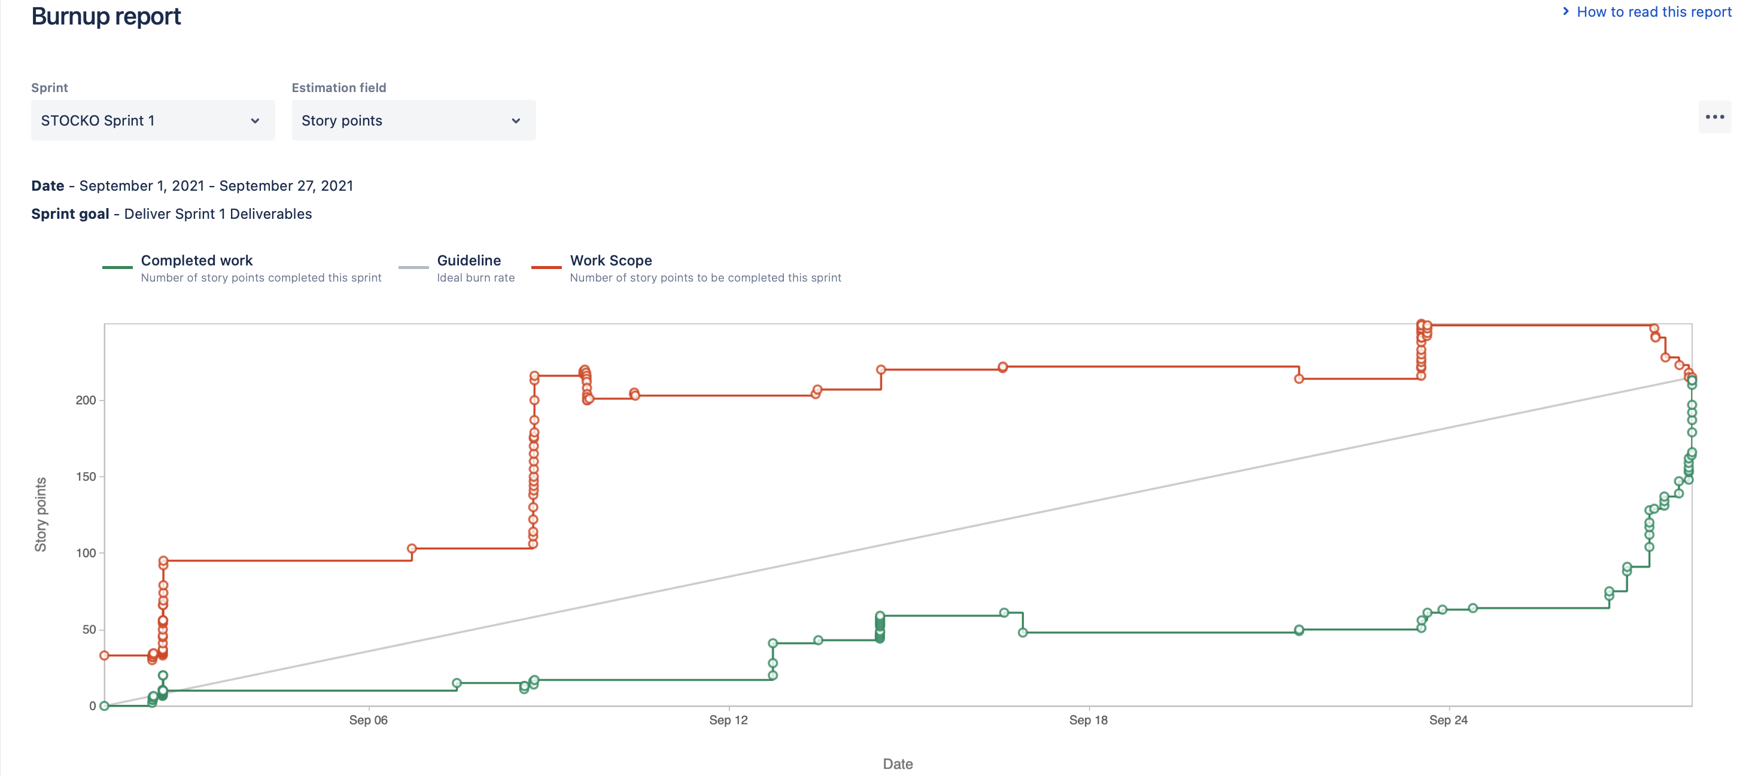
Burnup Chart (as of Sprint 1 Completion)

Slide 7
Sprint 1 Retrospective
No clearly defined Sprint 1 Scope
Better poker planning and ticket requirements before a sprint starts
Positions Add, Delete, and Edit requirement for application pushed to Sprint 2
3 bugs isolated to specific tickers pushed to Sprint 2
BABA and CIM free cash flow intrinsic value edge cases (CIM Issue addressed in STOCO-111)
AAPL bug has not been replicated again
Change in Shares Outstanding Pillar in Evaluations Feature pushed to Sprint 2
Alpha Advantage API doesn’t change their historic share data when stock splits and reversals happen
Solution will be implemented for this issue in Sprint 2
Biggest challenge was integrating team members
development into a Flask API

Slide 8

Demo

